Slide 1
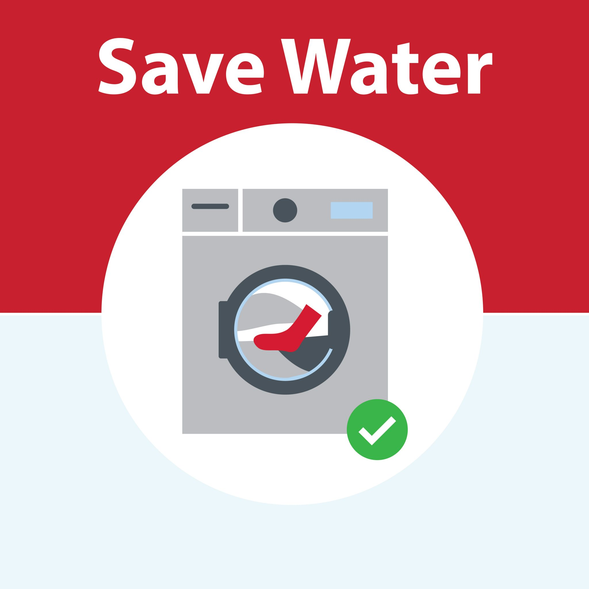
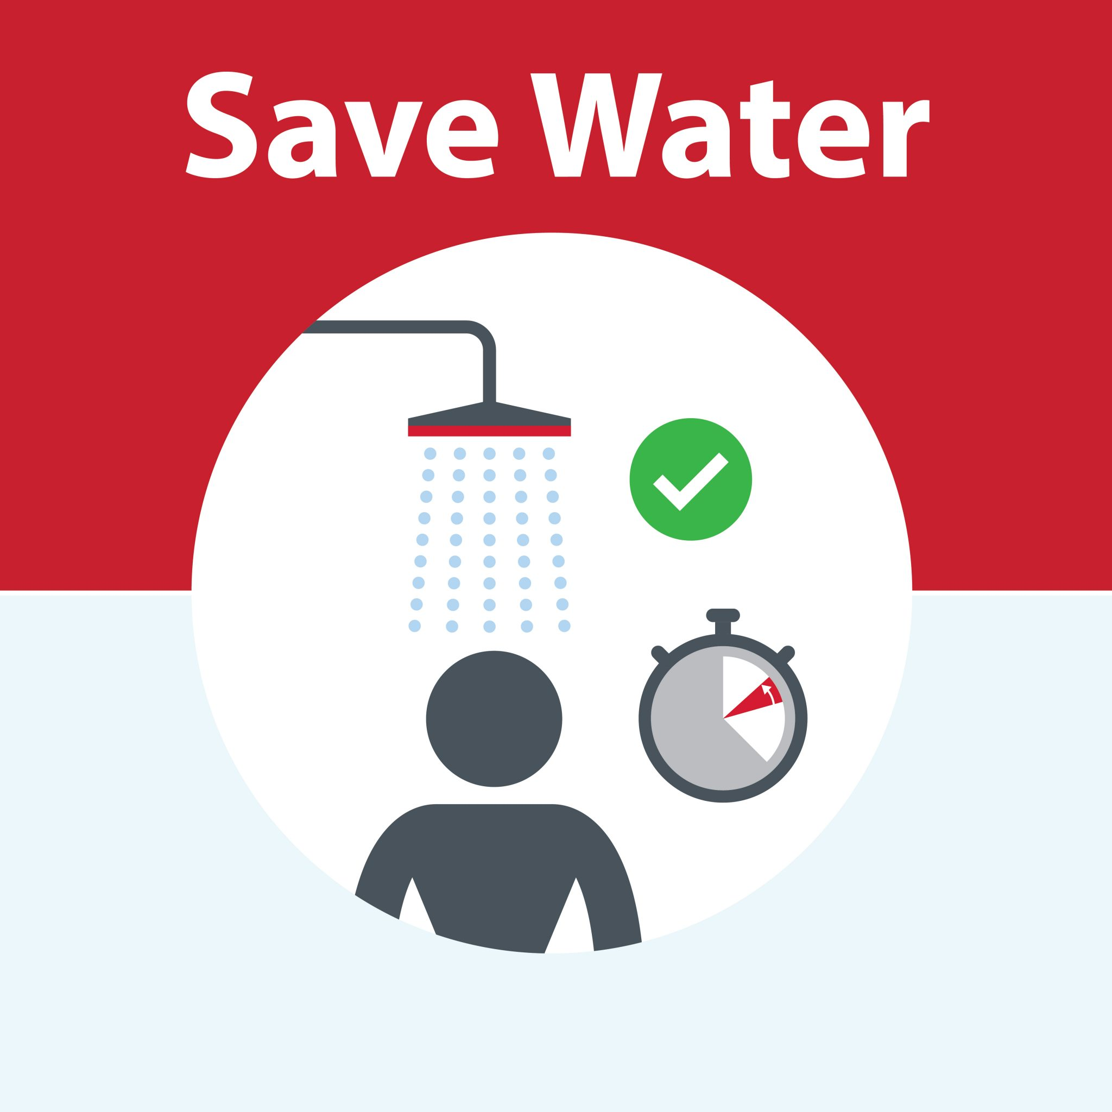
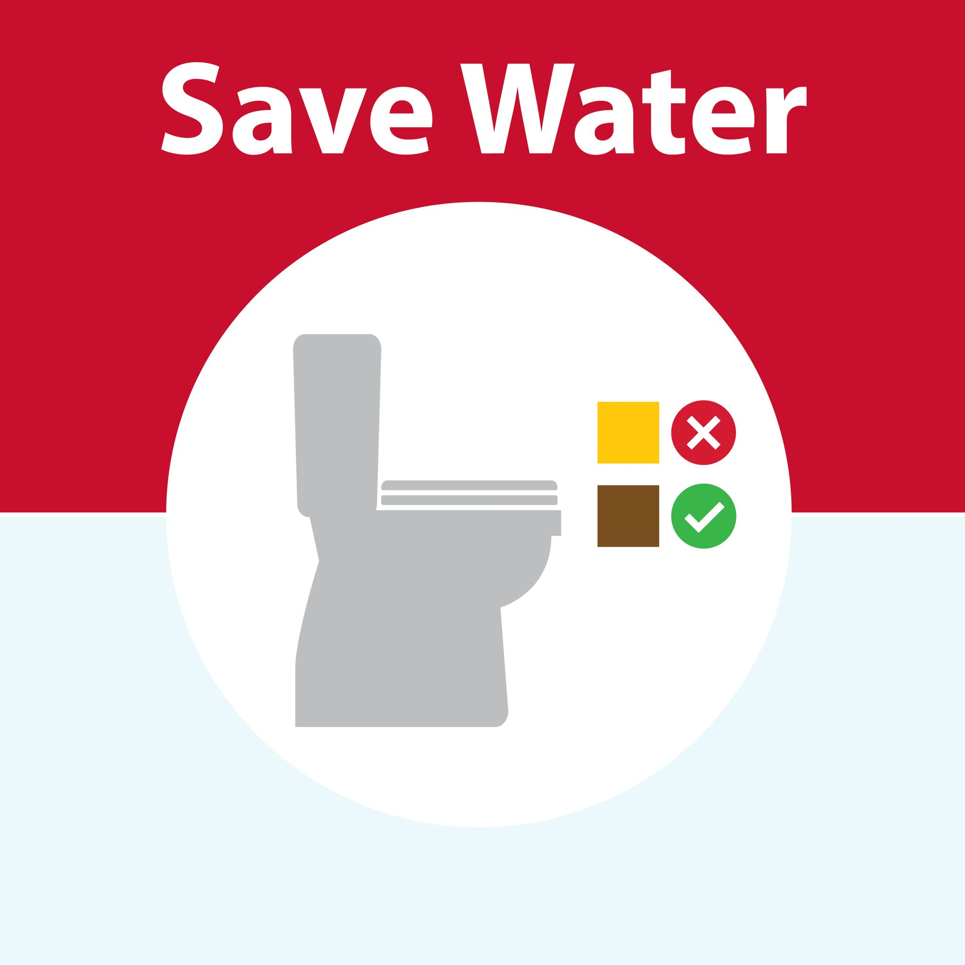

Slide 2
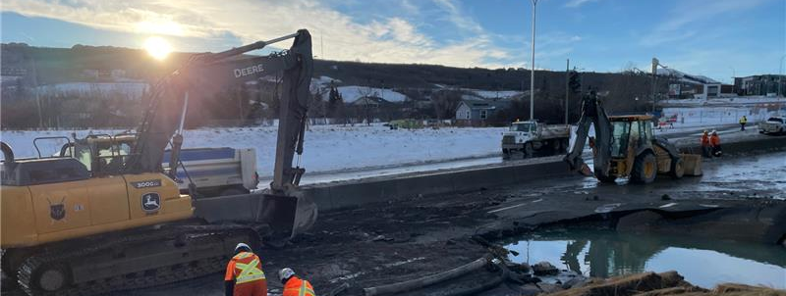
Bearspaw South Feeder Main Repair
Technical Briefing
January 1, 2026

Slide 3
1
Overview & Chronology

Slide 4
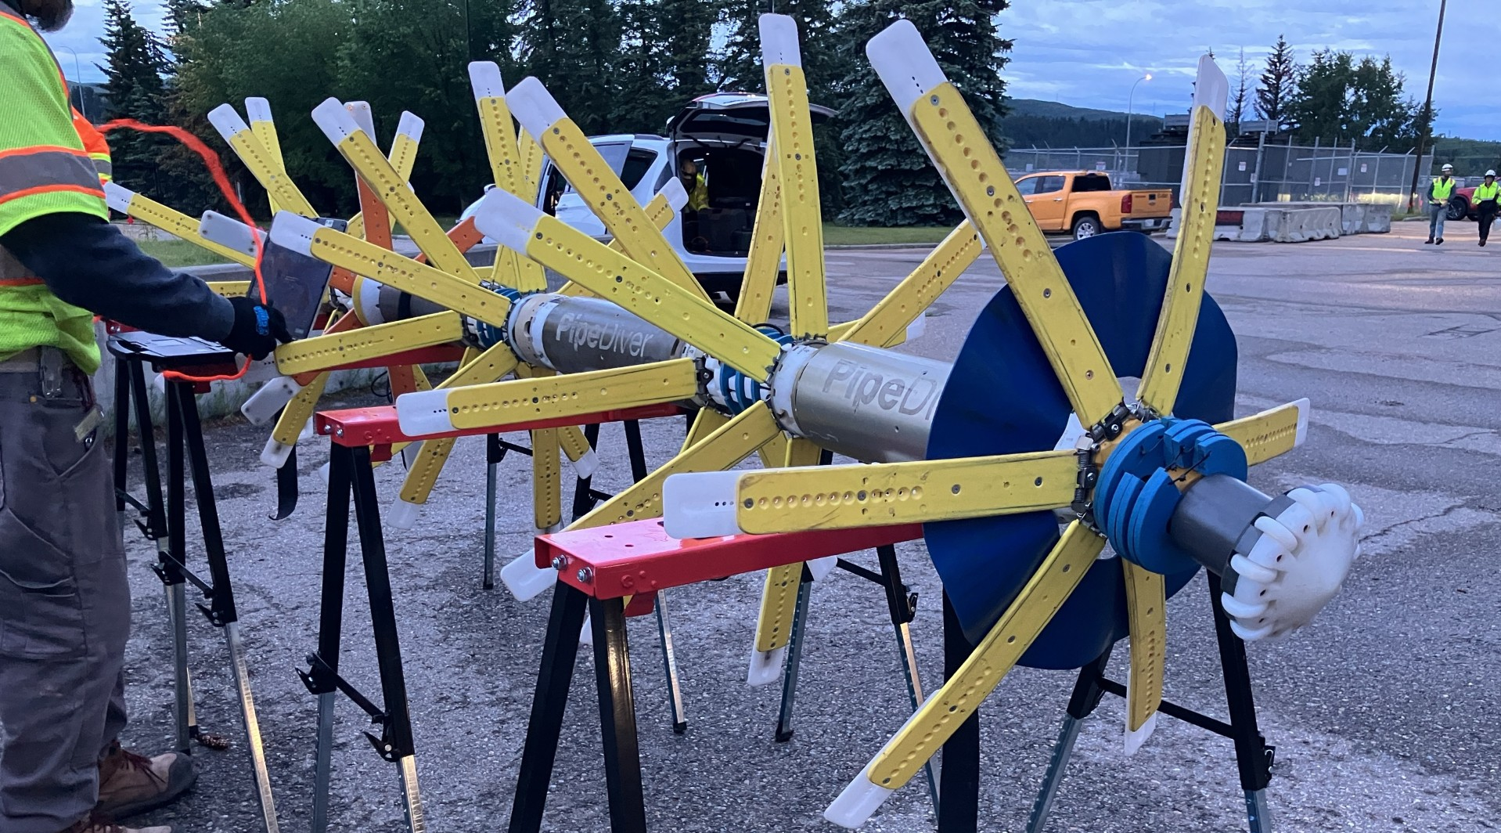

Slide 5
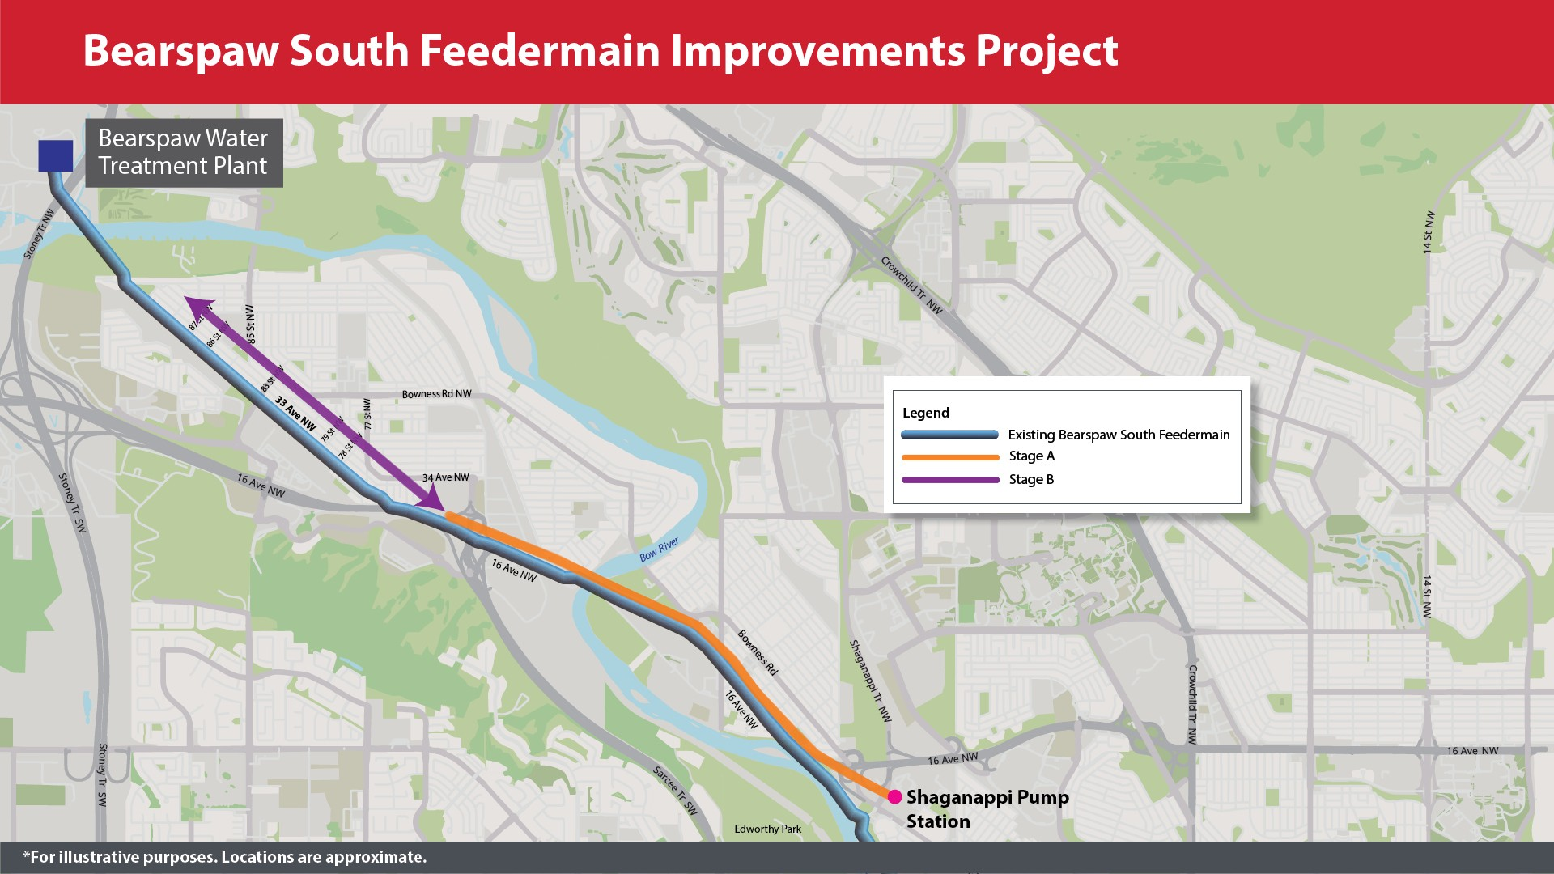

Slide 6
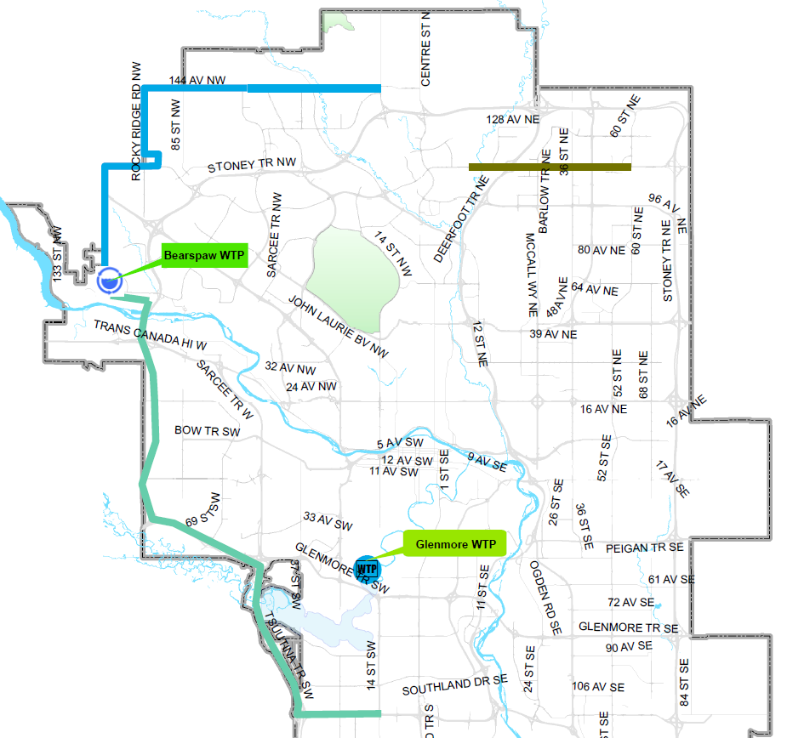
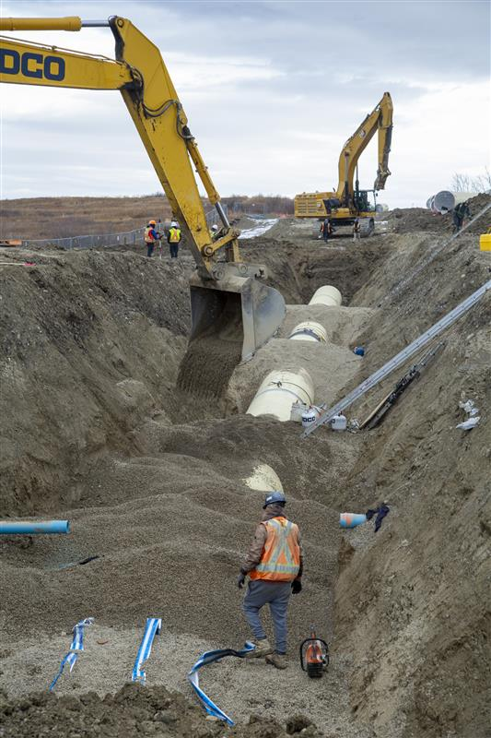

Slide 7
2
What we know.

Slide 8
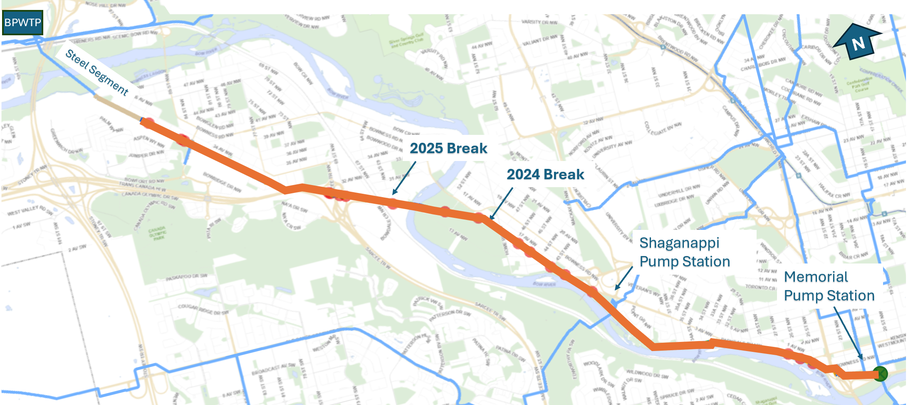
Acoustic Fibre Optic Monitoring System

Slide 9

Underground Storage of Treated Water
With reduced demand of 485 Million Litres per day
~4 days to
Storage Target
Typical 600 MillionLitres
468 Million Litres
459 Million Litres
Storage Before Failure
Dec 30, 2025
Storage After Failure
Dec 31, 2025
Today's Storage

Slide 10
3
What we don’t know.

Slide 11
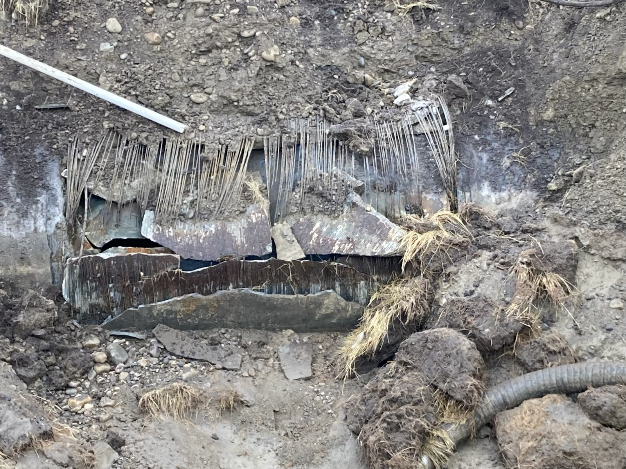
(Current pipe fail pic)
Nicole & Sean
December 30, 2025
Bearspaw South
Feeder Main
Failure

Slide 12
4
What has changed.

Slide 13
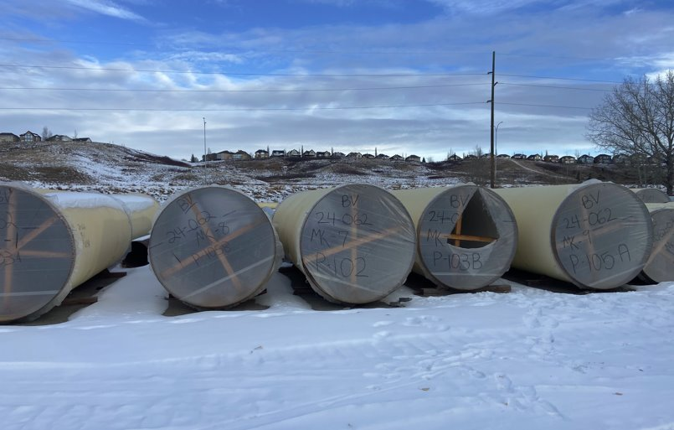

Slide 14
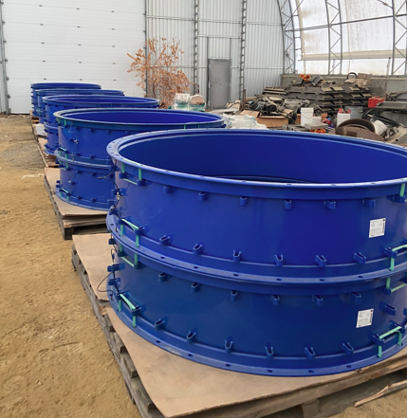
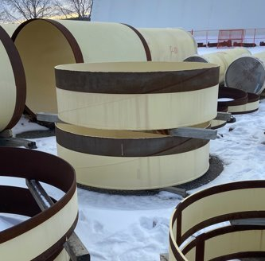

Slide 15
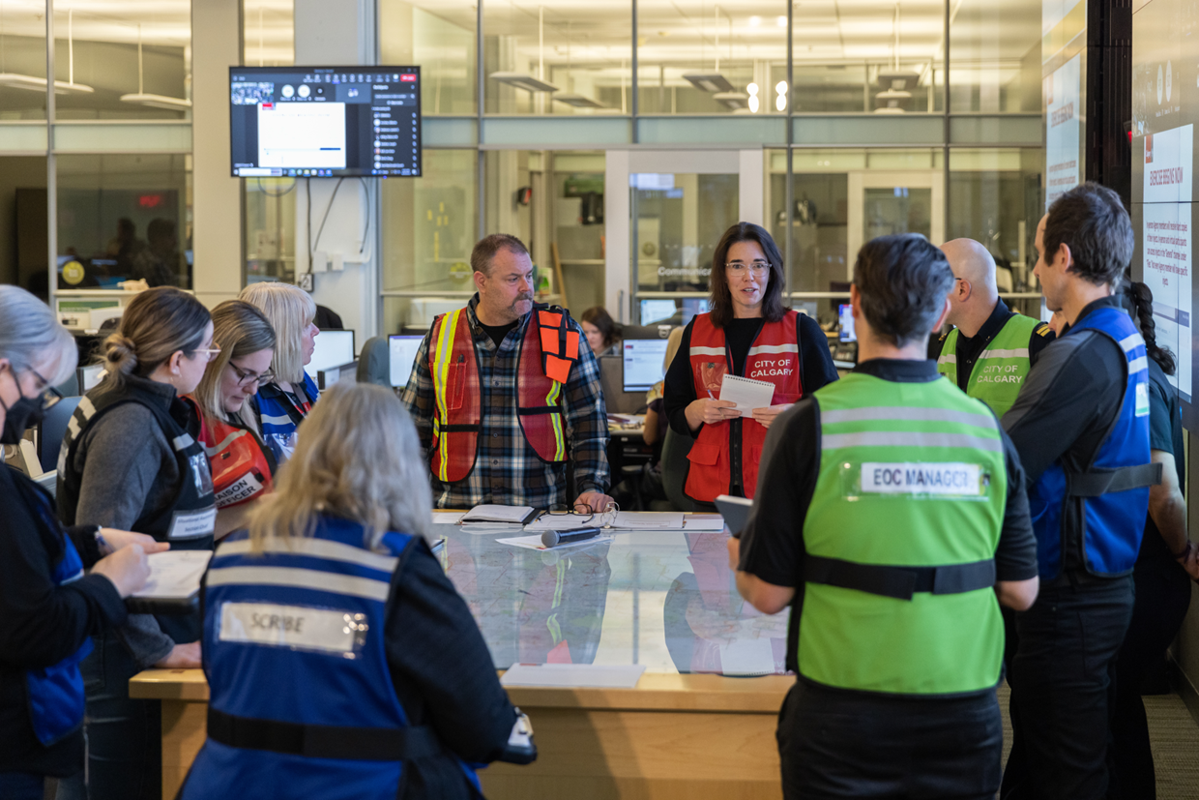

Slide 16
5
What we are doing now.

Slide 17
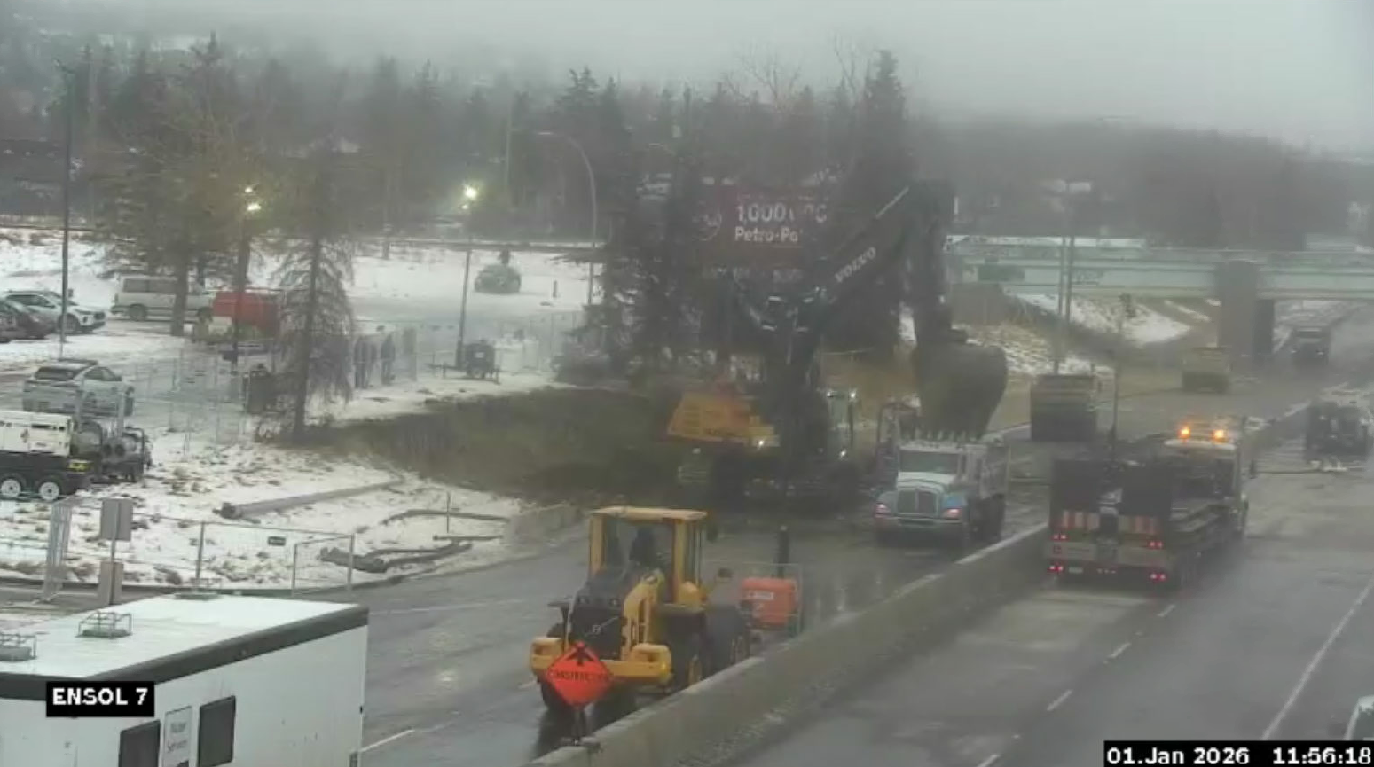
What are we doing now
Verified Screenshot of security cam

Slide 18
6
What we can do collectively.

Slide 19
